Slide 1

Intergalactic United Nations
Evan Wang
Stephan Manley

Slide 2
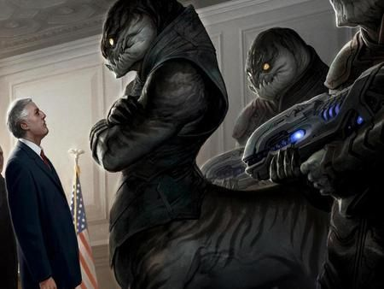
The Goal
With this Database, we sought to create a universe through which trillions of life forms, both human and non-human could interact to advance their political and economic endeavors.
Our clients in the Intergalactic United Nations need a database to keep track of it all.

Slide 3
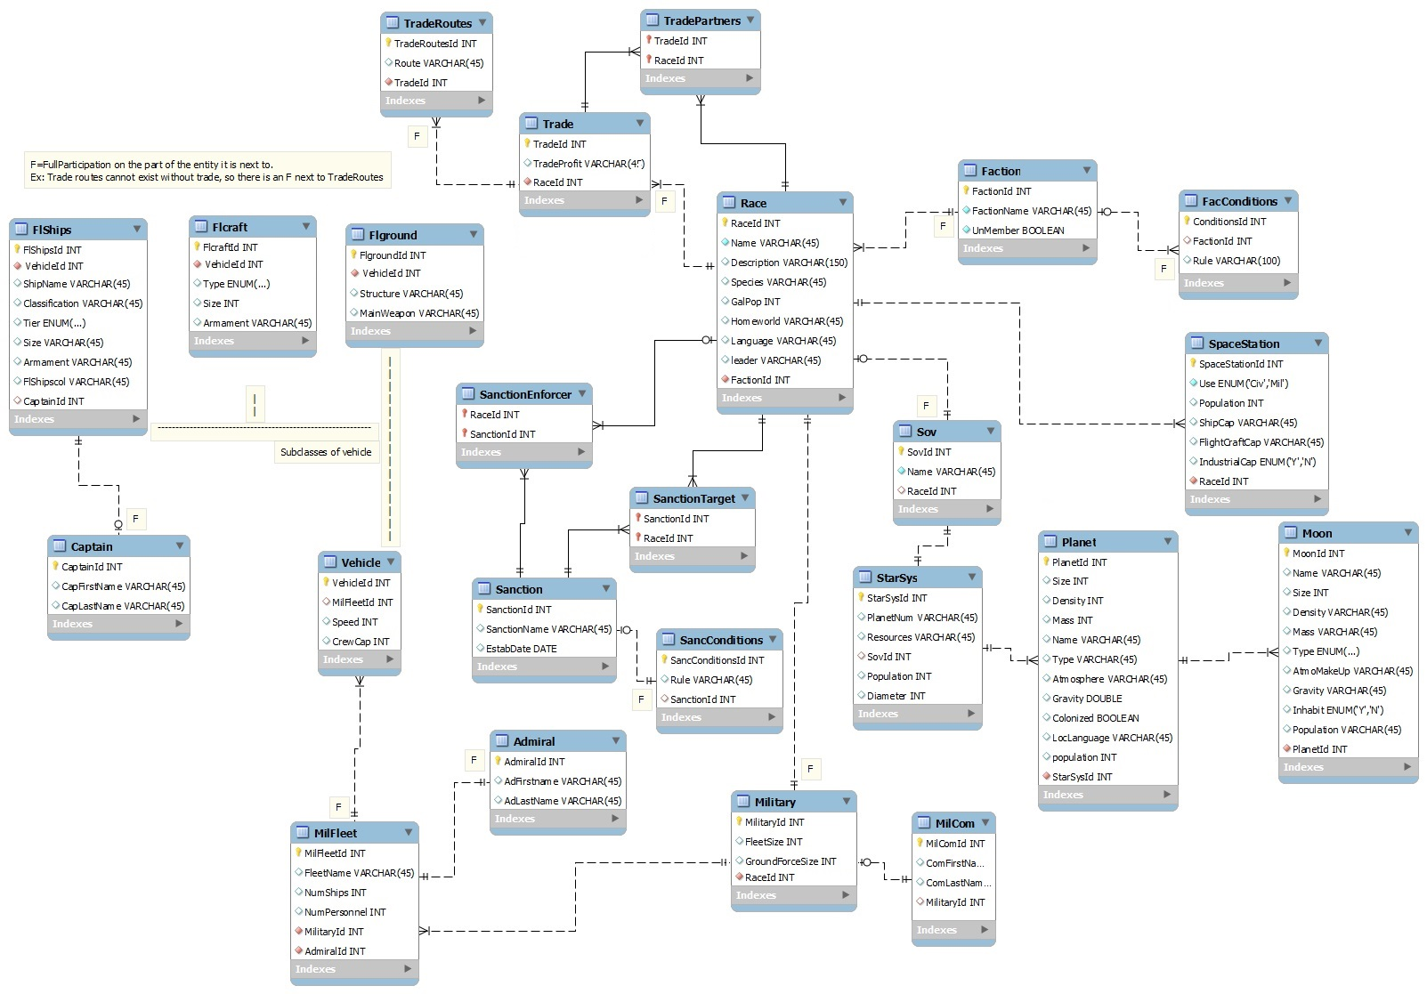

Slide 4
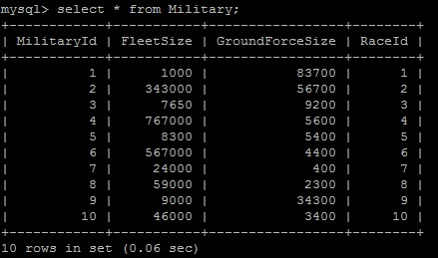
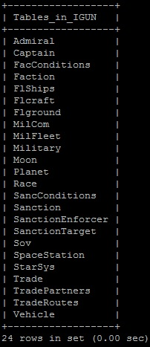
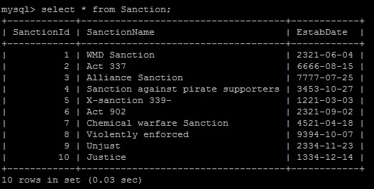
Now with 10 points of data in every table!
Database Tables

Slide 5
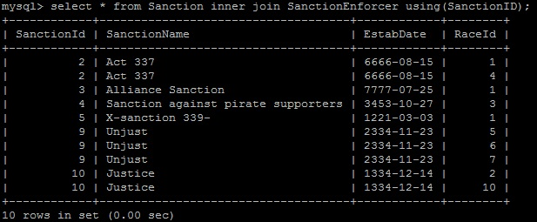
Super Important Queries
Select * from Sanctions Join SanctionEnforcer using(SanctionId);
Shows information about Sanctions imposed and by which races.

Slide 6
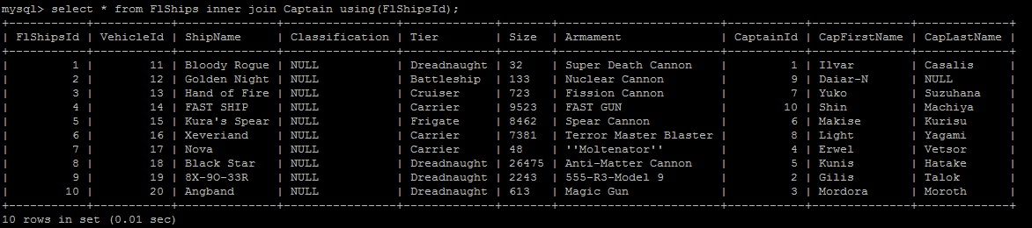
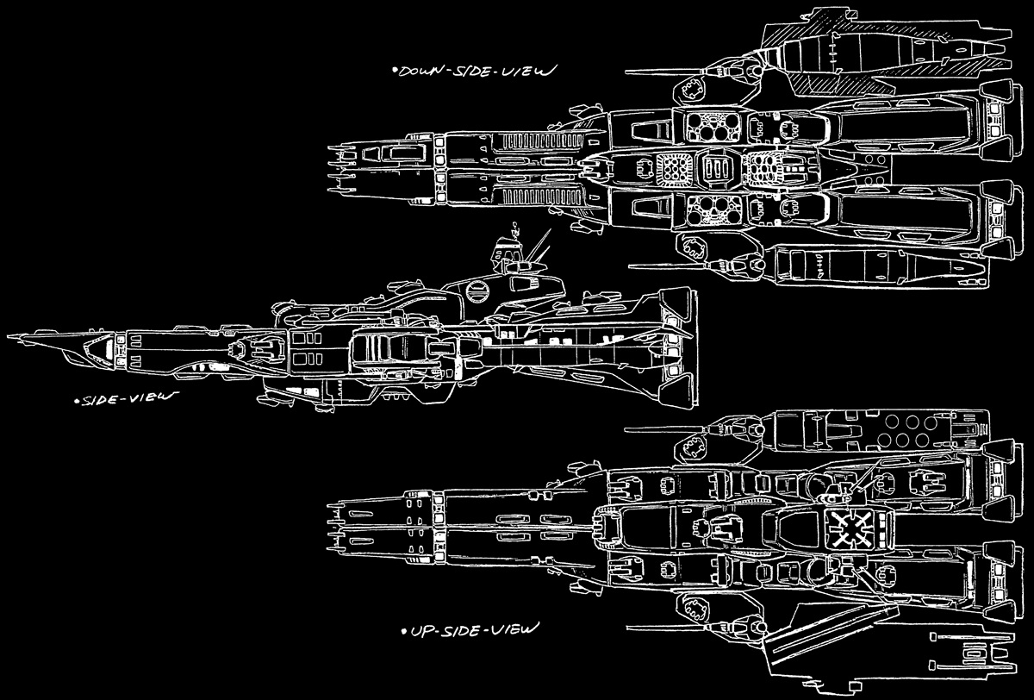
Some Military Information
Shows information about military ships and their captains.

Slide 7
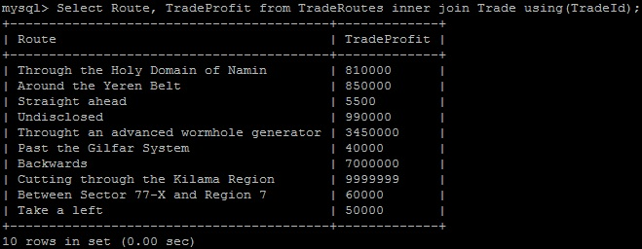
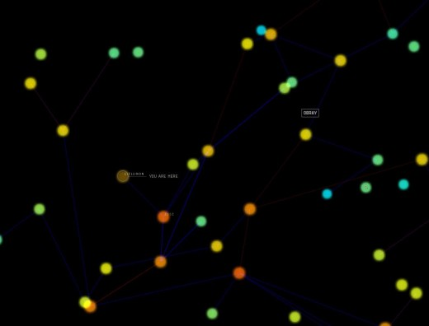
Some Economic Information
Shows the profit being made by each route.

Slide 8
We Used PHP Because….
PHP is a common web-based application that is used with many databases.
It’s versatile and easy to use once learned.
Neither of us knew how to use it.

Slide 9
We had difficulties…
Learning a new language in a short amount of time.
We had a lot of data, and entered over 240 entries by hand.
Keeping data when going backward through the database.
Shaping the Sanction and Trade branches properly.

